Slide 1
Automated in-situ sensors & Spatiotemporal Monitoring & Machine Learning prediction of Harmful Algal Blooms - Case Study-Lake Victoria
Presenter:
Name: OKELLO, JACOB OKOMO
Reg. No: ENC222-0149/2017

Slide 2
Introduction
Harmful Algal Blooms-HABs are a phenomenon in which the water body e.g. lakes turns dark blue-green because of excessive algal growth, potentially harming humans and animal, e.g., Unsightly nuisance, acute liver damage when the contaminated water is ingested, irritation, whatnot.
Why there’s need for this research
What have other researchers said about this issue?
What has been done to solve this problem?

Slide 3
Introduction
Move 1 establish your territory (say what the topic is about)
Move 2 establish a niche (show why there needs to be further research on your topic)
Move 3 introduce the current research (make hypotheses; state the research questions)
Start globally > regionally > nationally > locally outline the issue at hand.
What have other researchers said about this issue?
What has been done to solve this problem?

Slide 4
Problem statement
Previous studies on the same problem by
After reviewing the papers and gaps – what exactly is the problem? state this explicitly.
Ensure you mention the problem, area, and in detail the problem specifics

Slide 5
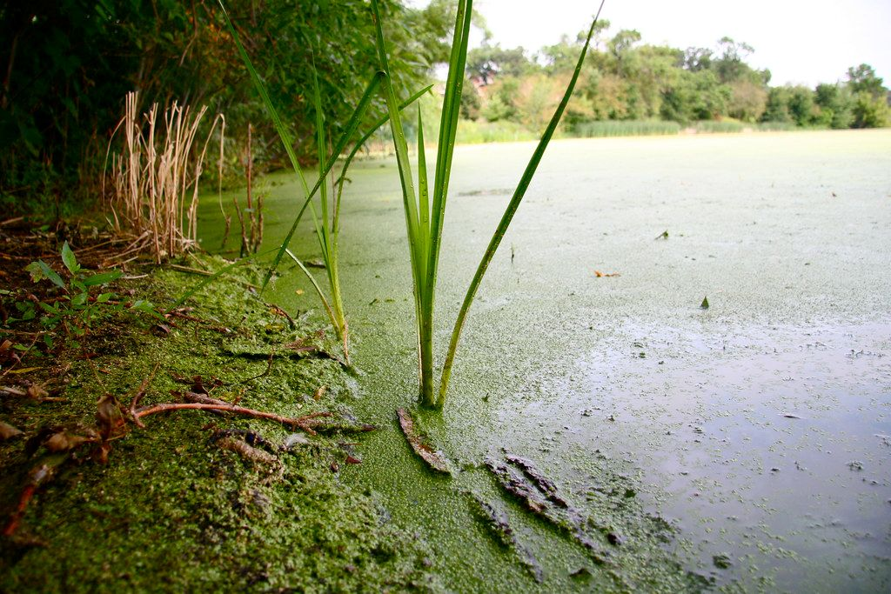
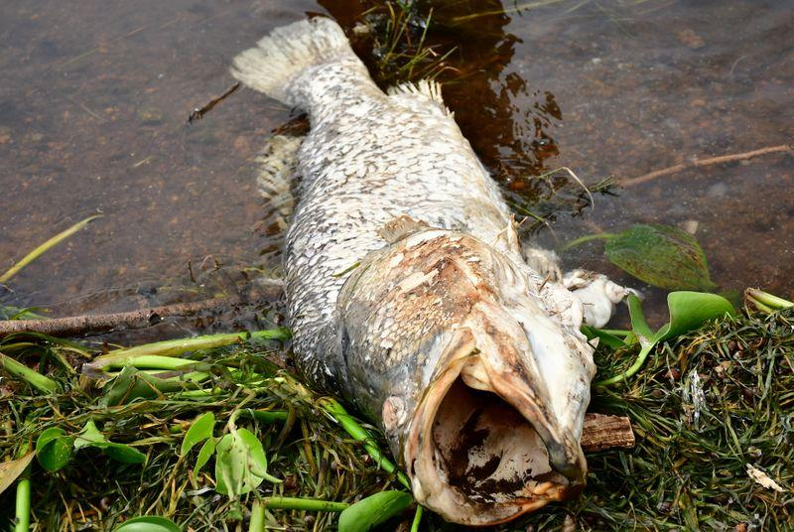
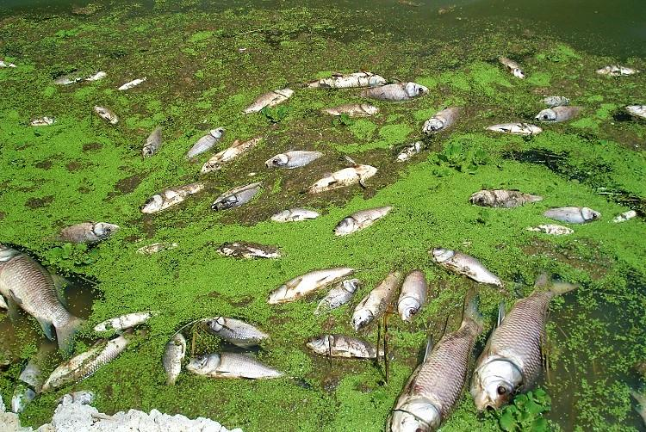
Justification

Slide 6
General and specific objectives
To monitor and predict the occurrence of Harmful Algal Blooms(HABs) and Cyanobacteria.
To develop automated in-situ Internet of Things(IoT) sensors to monitor the occurrence of the event.
To develop a system that reports specified geo-tagged data from the above sensors.
To associate Machine Learning models to predict the occurrence of CynoHAB.

Slide 7
Overall Methodology : Data and Materials
Data & Materials;
Data Type | Source | Access
Shapefiles | Database of Global Administrative Areas- GADM | Free
MODIS Aqua | Google Earth Engine Cloud Repo | Free
Landsat 8 OLI | Google Earth Engine Cloud Repo | Free
- Meteorology Data -In-Situ | -Lake Victoria Water Quality Mgt -My Automated In-situ System | -Uncertain -Within my control
Tool/ Material | Role | Availability
Google Earth Engine | Geocomputation & Processing | Freely Available
QGIS, R & Python | Further Analysis, Maps & Prediction | Free
Microcontroller, Sensors & Gateway | In-situ data collection & Monitoring | Local Purchase

Slide 8
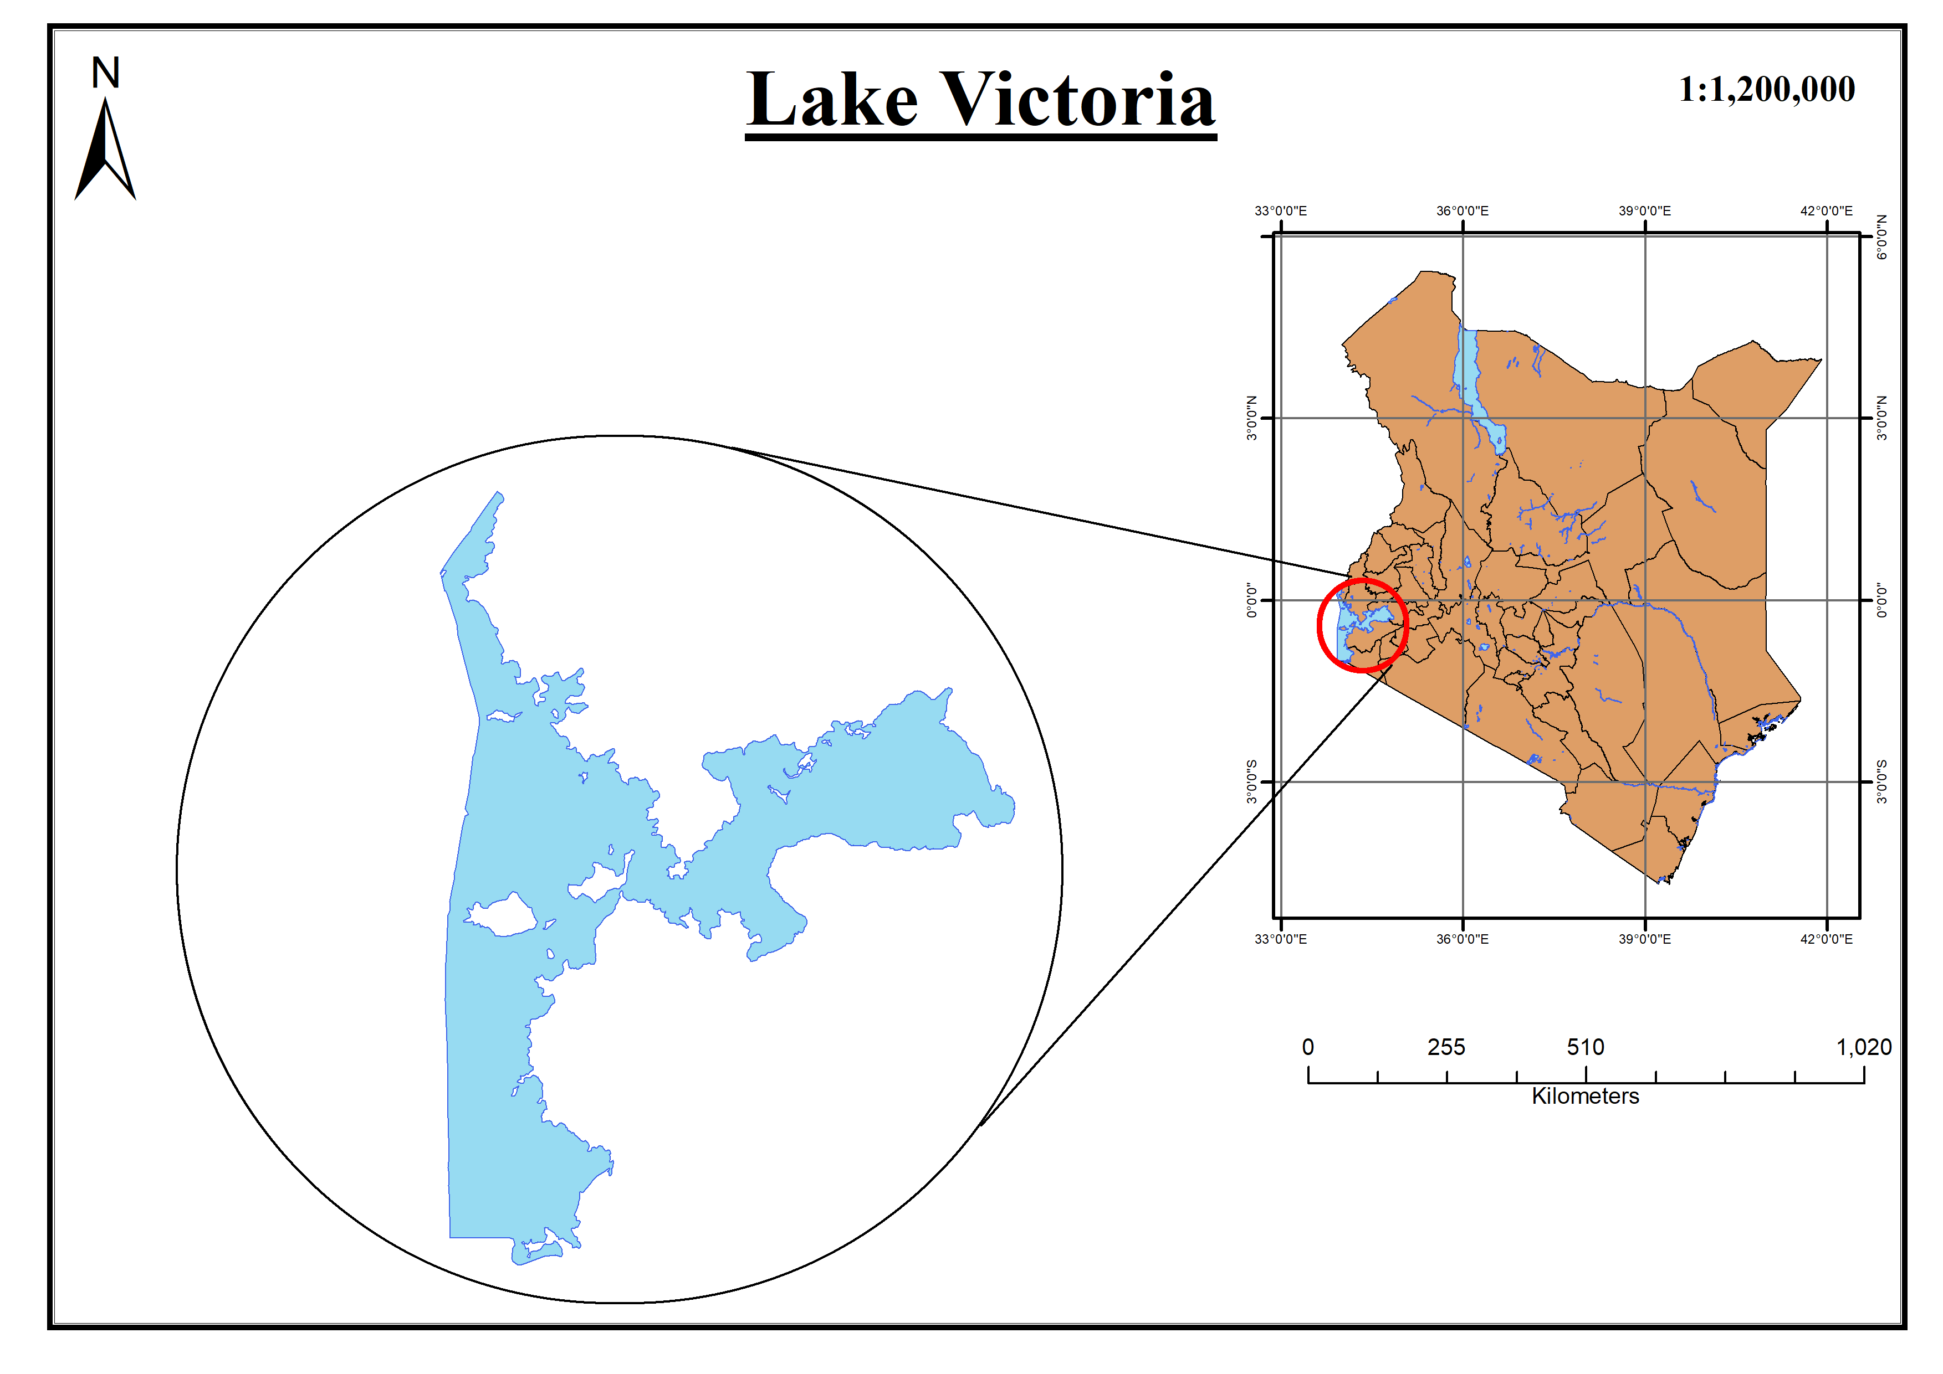
Study Area

Slide 9
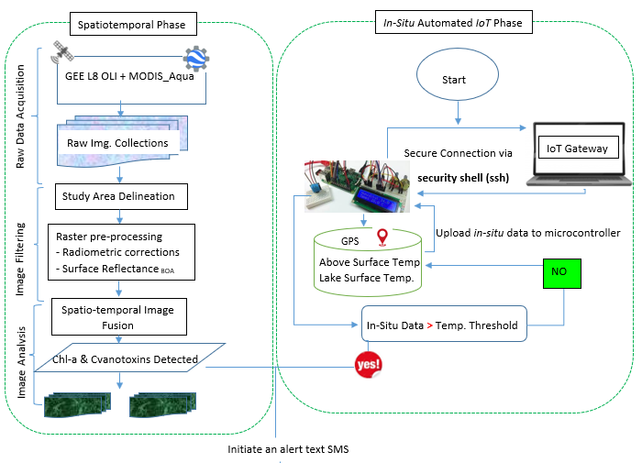
Overall methodology

Slide 10
Expected Results
Chlorophyl-a Geographical Maps associating the occurrence of the Harmful Algal Blooms and Cyanobacteria.
Automated system that monitors and reports geo-tagged data
Reported confirmation alert Text SMS reporting in near-real time the in-situ status from the sensors.
Time Series predictive model on any looming bloom.

Slide 11
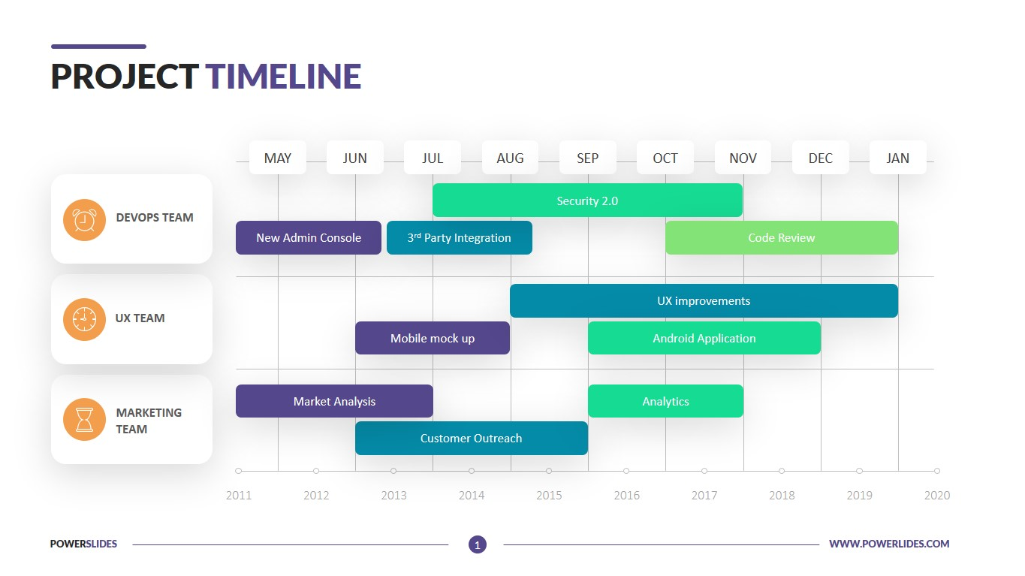
Project Timeline

Slide 12

Thank you for your attention! Questions?

